Slide 1
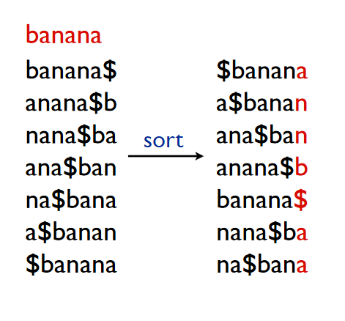
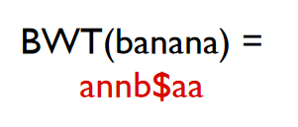


Inverting Burrows Wheeler Transform
The remarkable thing about BWT algorithm is that this particular transform is invertible.
Inverting Burrows Wheeler Transform means is to undo the BWT and recover the original text.
Let’s recall one example of BWT:
Burrows Wheeler Matrix
How to Invert the BWT? (Naïve Approach)
Construct the Burrows Wheeler Matrix back using the last column (BWT) of the Burrows Wheeler Matrix.
The first row of the BWM (all the characters after the $ sign) contains the actual/original text.

Slide 2
Inverting Burrows Wheeler Transform – Naïve Approach
How to Construct the Burrows Wheeler Matrix back using the last column (BWT) of the Burrows Wheeler Matrix?
- We only have the BWT of the original text on our hand, that is we only have the last column of the Burrows Wheeler Matrix (BWM). Using this information of the last column, we can get the first column back!
Burrows Wheeler Matrix
Sorting all the symbols / elements of the last column gives us the first column!

Slide 3
Inverting Burrows Wheeler Transform – Naïve Approach
How to Construct the Burrows Wheeler Matrix back using the last column (BWT) of the Burrows Wheeler Matrix?
When we have the first column and the last column of BWM, then we Prepend the last column to the first column and thus construct all the 2-mer compositions of the original text. Then we sort the 2-mers lexicographically to get back the first two columns of the BWM.
Now, we have the first two columns and the last column of BWM. We again Prepend the last column to the first two columns and thus construct all the 3-mer compositions of the original text. Then we sort the 3-mers lexicographically to get back the first three columns of BWM.
We repeat this process k amounts of time where k = length(BWT) – 1. Thus we reconstruct all the cyclic rotations of the original text. We sort them lexicographically and get back the BWM.

Slide 4
Inverting Burrows Wheeler Transform Naïve Approach (Example)
First 2 Columns of BWM
First 3 Columns of BWM
2-mers
3-mers
Last Column
First Column
a $
n a
n a
b a
$ b
a n
a n
$ b
a $
a n
a n
b a
n a
n a
a $ b
n a $
n a n
b a n
$ b a
a n a
a n a
$ b a
a $ b
a n a
a n a
b a n
n a $
n a n
a
n
n
b
$
a
a
$
a
a
a
b
n
n
Sort
Prepend
Sort
Sort
Prepend
First 4 Columns of BWM
Prepend
5-mers
4-mers
$ b a n a
a $ b a n
a n a $ b
a n a n a
b a n a n
n a $ b a
n a n a $
a $ b a n
n a $ b a
n a n a $
b a n a n
$ b a n a
a n a $ b
a n a n a
$ b a n
a $ b a
a n a $
a n a n
b a n a
n a $ b
n a n a
a $ b a
n a $ b
n a n a
b a n a
$ b a n
a n a $
a n a n
First 5 Columns of BWM
Sort
Prepend
Sort

Slide 5
Inverting Burrows Wheeler Transform Naïve Approach (Example)
First 6 Columns of BWM
7-mers, all
cyclic rotations
6-mers
$ b a n a
a $ b a n
a n a $ b
a n a n a
b a n a n
n a $ b a
n a n a $
a $ b a n a
n a $ b a n
n a n a $ b
b a n a n a
$ b a n a n
a n a $ b a
a n a n a $
$ b a n a n
a $ b a n a
a n a $ b a
a n a n a $
b a n a n a
n a $ b a n
n a n a $ b
a $ b a n a n
n a $ b a n a
n a n a $ b a
b a n a n a $
$ b a n a n a
a n a $ b a n
a n a n a $ b
First 5 Columns of BWM
Prepend
Sort
Prepend
$ b a n a n a
a $ b a n a n
a n a $ b a n
a n a n a $ b
b a n a n a $
n a $ b a n a
n a n a $ b a
Sort
Symbols after the $ sign in the first row spell the original text, that is banana
All 7 Columns of BWM

Slide 6
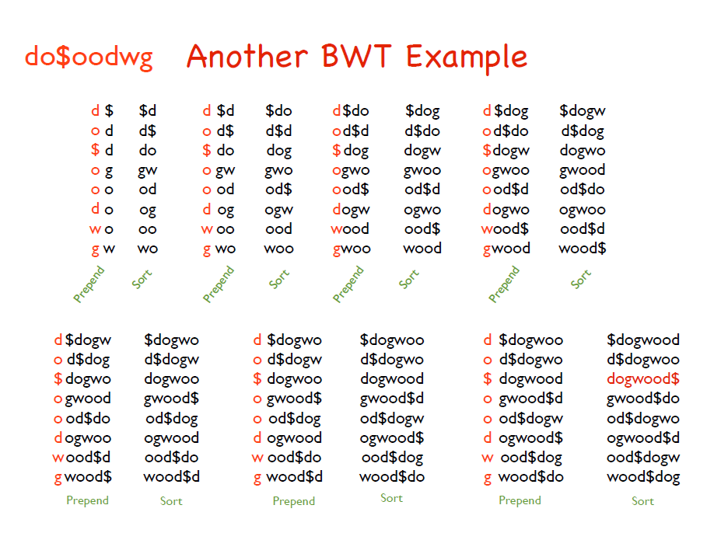
Inverting Burrows Wheeler Transform Naïve Approach (Example)

Slide 7
Inverting Burrows Wheeler Transform Naïve Approach
Limitations of this Naïve Approach:
Very slow.
Also we need |text| rounds of sorting.
Space consuming – Reconstructing the original text from the BWT(Text) in this approach requires us to store |text| amount of cyclic rotations.
Can we reconstruct the original text using less space and in a more quickly manner than this Naïve approach?

Slide 8
Inverting Burrows Wheeler Transform Last to First Mapping (LF Mapping)
Steps of LF Mapping:
Given the Last column of the Burrows Wheeler Matrix, construct the First Column of the Matrix by sorting all the elements of the Last column lexicographically.
Conduct mapping elements recursively between the Last column and the First column until we get back the original text.
Last Column
First Column
First Column
Last Column
a
n
n
b
$
a
a
$
a
a
a
b
n
n
$
a
a
a
b
n
n
a
n
n
b
$
a
a
Sort
Mapping
Is the same order is followed by the multiple occurrences of the same character in these two columns?
or a different order?

Slide 9
Inverting Burrows Wheeler Transform Last to First Mapping (LF Mapping)
Interesting Observations:
1. “The k-th occurrence of a character in the last column corresponds to the same k-th occurrence of that character in the first column”
That is, 1st occurrence of a character in the last column will correspond/map to the 1st occurrence of that same character in the first column.
2nd occurrence of a character in the last column will correspond/map to the 2nd occurrence of that same character in the first column.
so on………

Slide 10
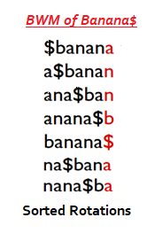




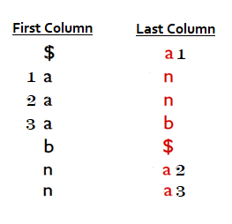
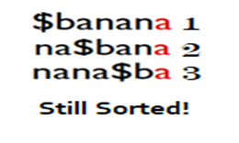

Inverting Burrows Wheeler Transform Last to First Mapping (LF Mapping)
Let’s deal with the
occurrences of a
Same concept applies
for the occurrences of
other characters!

Slide 11
Inverting Burrows Wheeler Transform Last to First Mapping (LF Mapping)
2. “The k-th occurrence of the any character in the first column and the k-th occurrence of that same character in the last column corresponds to the appearance of that character in the same position in the text!”
b
$
a
a
n
n
a
How to know at which place the character is appeared in the text?

Slide 12
Inverting Burrows Wheeler Transform Last to First Mapping (LF Mapping) - Example
Reconstruct the original text from the following BWT using LF Mapping:
“annb$aa”
First Column
Last Column
First Column
Last Column
$
a
a
a
b
n
n
a
n
n
b
$
a
a
$
a30
a15
a45
b1
n10
n7
a30
n10
n7
b1
$
a15
a45
$
b1
a45
n7
a15
n10
a30
$banana
banana

Slide 13
Inverting Burrows Wheeler Transform Last to First Mapping (LF Mapping) - Example
Reconstruct the original text from the following BWT using LF Mapping:
“do&oodwg”
First Column
Last Column
First Column
Last Column
$
d
d
g
o
o
o
w
d
o
&
o
o
d
w
g
$
d1
d2
g1
o3
o2
o1
w1
d1
o3
$
o2
o1
d2
w1
g1
$
d2
o2
g1
w1
o1
o3
d1
$dogwood
dogwood

Slide 14
Necessary Links
https://www.cs.cmu.edu/~ckingsf/bioinfo-lectures/bwt.pdf
https://www.geeksforgeeks.org/burrows-wheeler-data-transform-algorithm/
https://en.wikipedia.org/wiki/Burrows%E2%80%93Wheeler_transform
https://www.coursera.org/lecture/algorithms-on-strings/inverting-burrows-wheeler-transform-C0opC

